Slide 1
Door Theft Automation
In this project; we will make an IoT based Door Security system using a Magnetic Reed Switch, NodeMCU ESP8266 Wifi Module, and Blynk application. Each time the door is opened , a notification message is sent to the desired application.
The Nodemcu ESP8266 Wifi Module programming is done in such a way that it sends only one notification message when the door is opened which became possible by using a flag in the programming.

Slide 2
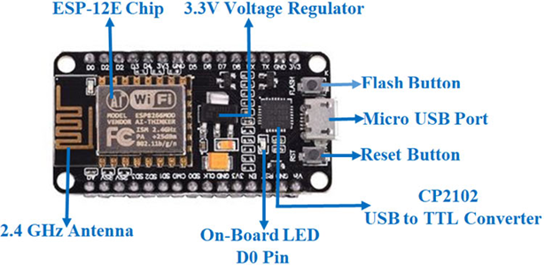

Components Required
SOFTWARE:
1) Arduino IDE
2) Blynk App
NodeMCU Board Magnetic Reed Switch
HARDWARE :
1) NodeMCU Development board
2) Magnetic Reed Switch
3) Bread Board

Slide 3
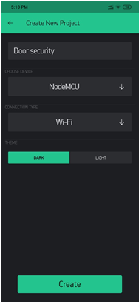
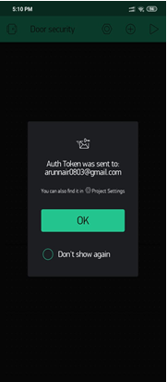
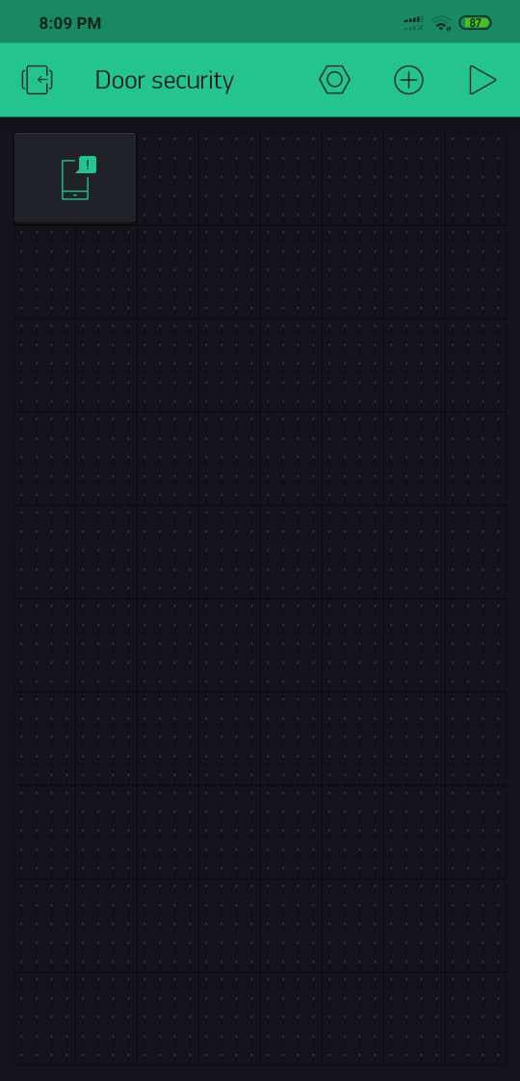
How to use Blynk Application ?
Open the Blynk application
Click on the new project and enter the project name as Door Security
Click on the choose device and select NodeMCU
Make sure you set the connection type to WIFI
Finally, click on the create button, an authentication token will be sent on your email ID which will be then used in the programming. Simply copy and paste it in the programming…
Now click on the add button on the screen and search for the notification and add it
Our application is ready.

Slide 4
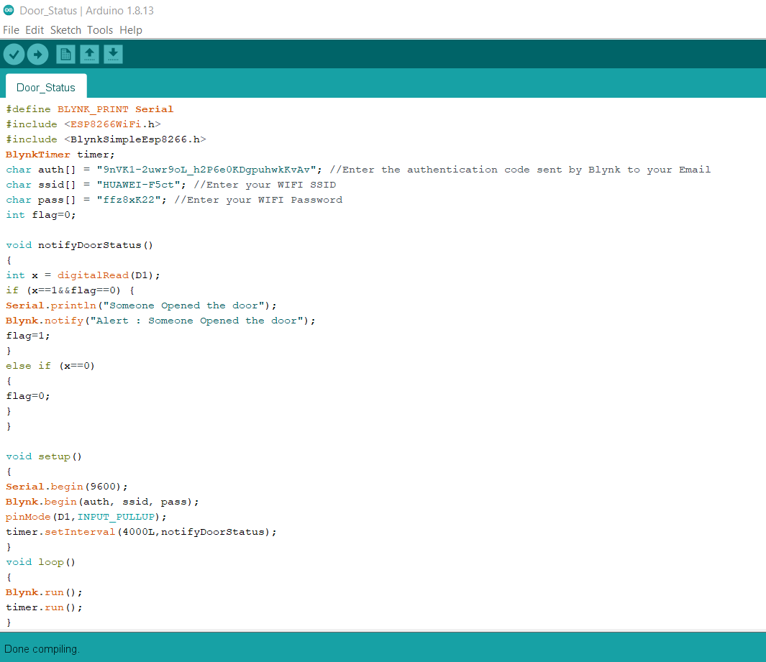
Programming on Arduino IDE

Slide 5
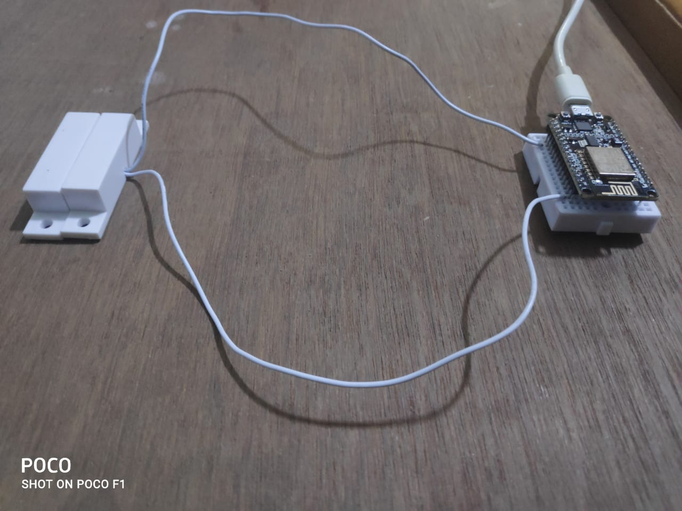
Hardware Setup
Connect one wire of the magnetic switch to the D1 pin and another to the ground pin with the help of bread board

Slide 6
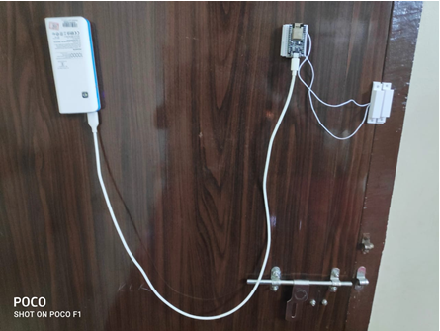
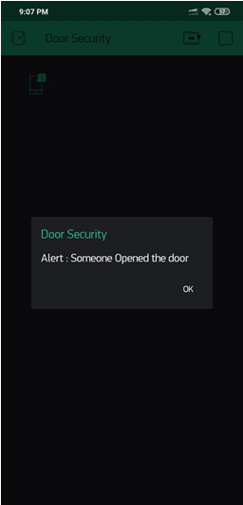
MODEL SETUP and OUTPUT
.
After uploading the code on the board , remove the extension cord from the laptop and connect it to a power bank as power supply is required for the working of the board .The model setup will be completed . Now place the setup on any door whose status is to be monitored.

Slide 7
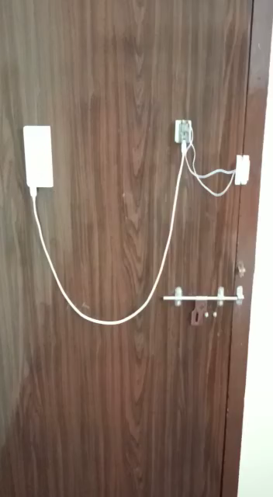
VIDEO DEMONSTRATION

